Slide 1
Working with the web part property pane
Building custom property pane fields

Slide 2
Agenda
Add a custom property pane field
Loading mock and SharePoint data into a custom property pane field
Creating custom property pane controls
Q&A

Slide 3
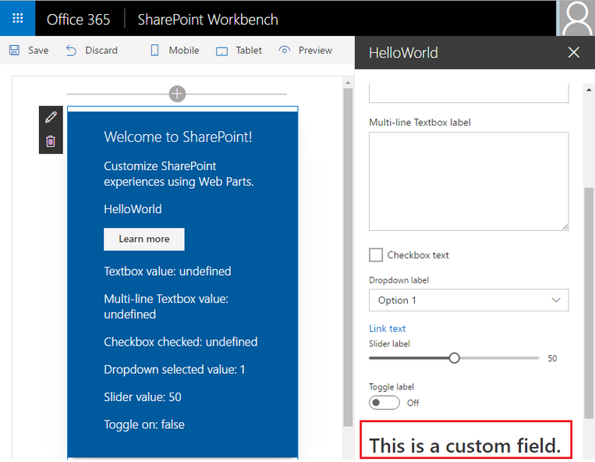
Overview
The property pane supports the following field types out-of-the-box
Label
Textbox
Multi-line Textbox
Checkbox
Dropdown
Link
Slider
Toggle
Custom
You may also create your own custom field types

Slide 4
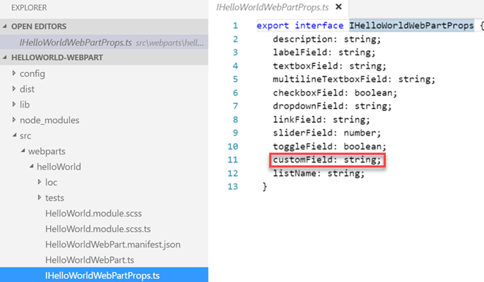
Implementing custom property pane fields
Define an interface in your web part class that includes one or more target properties

Slide 5
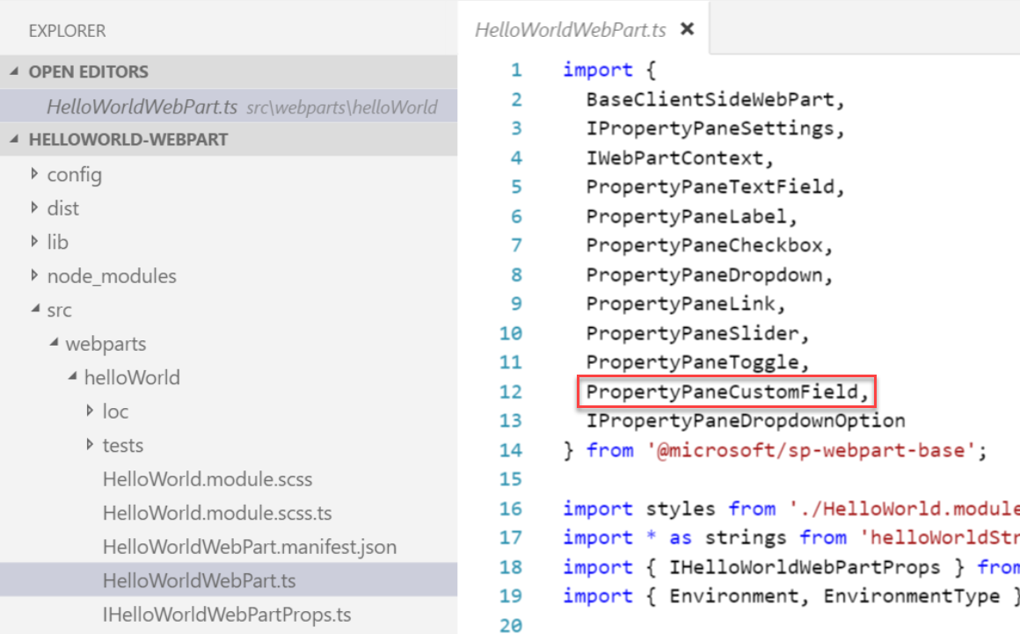
Implementing custom property pane fields
Import the PropertyPaneCustomField field type in the web part class
The PropertyPaneCustomField field type is available as a modules in the sp-webpart-base library

Slide 6
Implementing custom property pane fields
In the web part class, create a render method for the custom field
In the propertyPaneSettings method, add the custom field definition in a groupFields array
private _customFieldRender(elem: HTMLElement): void {
elem.innerHTML = '<div><h1>This is a custom field.</h1></div>';
}
protected get propertyPaneSettings(): IPropertyPaneSettings {
return {
pages: [
{
header: {
description: strings.PropertyPaneDescription
},
groups: [
{
groupName: strings.BasicGroupName,
groupFields: [
PropertyPaneCustomField('customField', {
onRender: this._customFieldRender.bind(this)
}),
]
}
]

Slide 7
Loading async mock data into a web part property field
Define a field in the web part interface
Define a variable to store the field data
Define a method return the mock data
Add an onInit method in the web part class that invokes a method to create mock data, and set the variable that holds the field data
Modify the field definition in the groupFields array to use the data

Slide 8
Example: Loading async mock data into a dropdown field
Define a dropdown field in the web part interface
Define a variable to store the dropdown options
Define a method return the mock data
import {
PropertyPaneDropdown
} from '@microsoft/sp-webpart-base';
private _options: IPropertyPaneDropdownOption[];
private _getLists(): Promise<any> {
if(Environment.type === EnvironmentType.Local) {
return new Promise<any>(resolve => {
setTimeout(() => resolve([
{Id: '1', Title: 'Mock List 1'},
{Id: '2', Title: 'Mock List 2'}]),
500);
});
}

Slide 9
Example: Loading async mock data into a dropdown field
Add an onInit method in the web part class that invokes a method to create mock data, and set the variable that holds the field data
Modify the field definition in the groupFields array to use the variable that holds the field data
protected onInit(): Promise<void> {
return this._getLists().then(lists => {
this._options = lists.map(list => {
return {
key: list.Id,
text: list.Title
}
});
});
}
PropertyPaneDropdown('listName', {
label: 'Select a list',
options: this._options
})

Slide 10
Loading async SharePoint data into field
Update the method used to return the mock data to return SharePoint data when the web part is not running the local environment
private _getLists(): Promise<any> {
if(Environment.type === EnvironmentType.Local) {
return new Promise<any>(resolve => {
setTimeout(() => resolve([
{Id: '1', Title: 'Mock List 1'},
{Id: '2', Title: 'Mock List 2'}]),
500);
});
}
else {
return this.context.httpClient.get(this.context.pageContext.web.absoluteUrl +
`/_api/web/lists?$filter=Hidden eq false`)
.then((response: Response) => {
return response.json();
}).then((json) => {
return json.value;
});
}
}

Slide 11
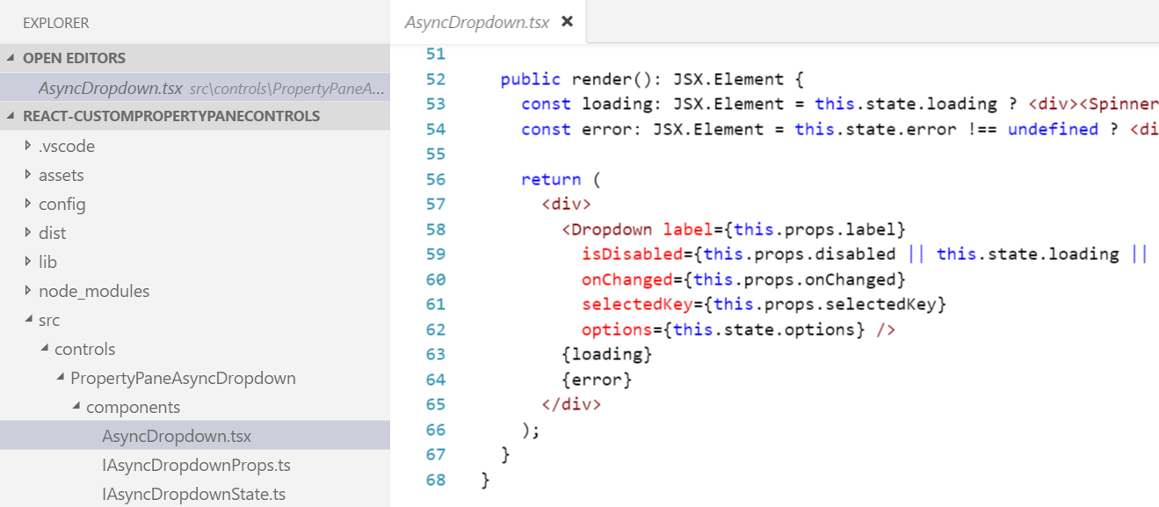
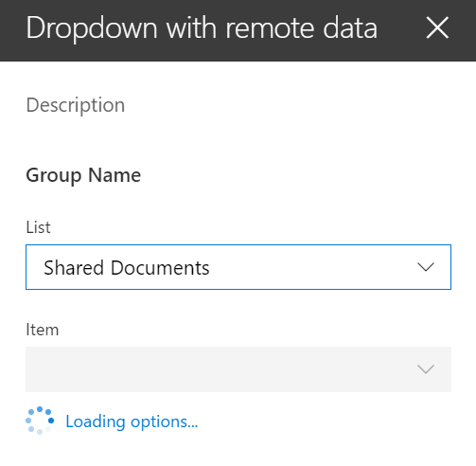
Creating custom property pane controls
When out-of-the-box property pane controls don’t meet your needs you can create your own custom controls
Creating custom controls promotes code reusability
https://github.com/SharePoint/sp-dev-fx-webparts/tree/master/samples/react-custompropertypanecontrols

Slide 12
DEMO
Building custom property pane fields
Notes:
Use Exercise 2: Building custom property pane fields in the lab manual.

Slide 13
Summary
Add a custom property pane field
Loading mock and SharePoint data into a custom property pane field
Creating custom property pane controls
Q&A

Slide 14

Sharing is caring…
Code samples and solutions
Reusable components
Guidance documentation
Monthly community calls
SharePoint Framework
SharePoint add-ins
Microsoft Graph
Office 365 APIs
http://aka.ms/SharePointPnP

Slide 15

Q&A

Slide 16


